Slide 1
Animation of Ball Collisions
ENGR 122
Section – 84
Group 2
Professor – Naga Kandadsamy
TA - Guyene Han
Alexander Tweed
Zohaib Javed
Neel Patel

Slide 2
Problem Statement
Create a screensaver, in which balls collide changing direction and color that will accept user input to customize: ​
Size of the window​
Number of balls in the window
Number of possible colors as the balls collide

Slide 3
Approach
The program was divided into 6 functions and compiled together into one main file.
Building the program in separate functions then compiling them creates a simpler more easily understood code making troubleshooting easier.​
Functions/Steps of the file​
Create Window​
Get Center​
Draw Ball​
Infinite Loop​
Check for Collisions​
i. If Collision Occurs Change Color and Direction ​
b. Add/Subtract one pixel to Balls position for X and Y ​
c. Redraw

Slide 4
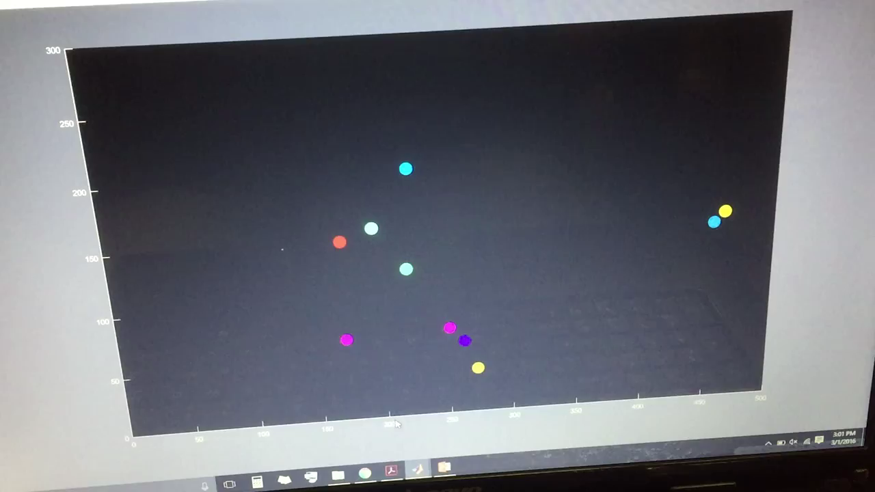
MATLAB Code

Slide 5
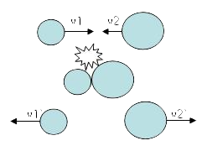

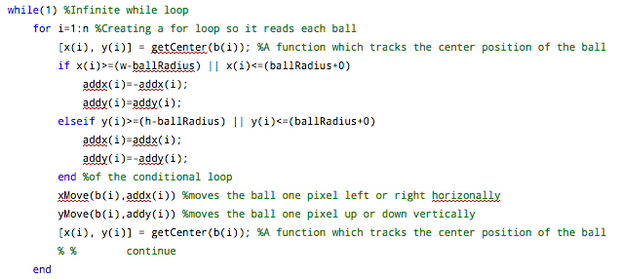
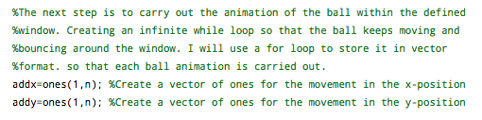
Challenges
One the of the key challenges we faced was identifying collisions and programing the balls to react naturally​
Another challenge in creating the screensaver was updating the each ball's position to simulate movement ​
​

Slide 6
Contributions
All the team members have equal contribution in making the functions to make this program work successfully.​
Each team member also worked together to make this presentation.

